Slide 1
Certified Ethical Hacker
Certification Prep Day 1

Slide 2
Class Objectives
By the end of class today, students will be able to:
Explain what the Certified Ethical Hacker Exam is and which Info Sec fields would benefit from obtaining the certification.
List the requirements, prerequisites and details of the exam.
List the Domains covered in the exam that have/haven't been covered previously in our class
Complete a practice test

Slide 3
Introduction to CEH

Slide 4
What is a Certified Ethical Hacker?
According to the EC-Council*
A skilled professional who understands how to look for weaknesses and vulnerabilities in target systems.
Uses the same knowledge and tools as a malicious hacker in a lawful and legitimate manner to assess the security posture of a target system.
* EC-Council is an organization that certifies qualified applicants in various e-business and infosec security skills.
They provide testing and certification for CEH as well as more advanced certifications for ECSA (Certified SEcurity Analyst) and LPT (Licensed Penetration Tester)

Slide 5
Introduction to CEH Certification
What are some jobs that may require the CEH certification?
Penetration Testing
Read Team/ Blue Team
Ethical Hackers
Security Specialists
Information Security Analysts
Security or Systems Administrators
Application Security Engineers
Vulnerability Management

Slide 6
Introduction to CEH Certification
What will you learn with the certification?
Footprinting and Reconnaissance
Scanning and Enumeration
Vulnerability Analysis
System Hacking
Malware Threats
Sniffing
Social Engineering
Denial-of-Service
Session Hijacking
Evading IDS, Firewalls, and Honeypots
Hacking Web Servers
Hacking Web Applications
SQL Injection
Hacking
Wireless Network Platforms
IoT Hacking
Cloud Computer
Cryptography

Slide 7

When should you consider taking the CEH Exam
While CEH is considered an entry-level exam and certification, the applicant must complete one of three credentials to take the exam:
Attended training at an Accredited Training Center
Completed iClass, through EC-Council's learning portal
Completed Self Study, after an application and proof of two years relevant Info Sec experience is provided
Without two years of experience, you can also request consideration based on educational background

Slide 8
CEH Specs
The CEH Certification is obtained through passing the CEH V10 version of the Exam.
There are 125 multiple-choice questions on the exam.
The exam lasts 4 hours.
The cost of the exam is $500.
The exam is vendor-neutral.

Slide 9
How is the Exam Graded?
According to EC-Council:
EC-Council Exams are provided in multiple forms (i.e. different question banks).
Each form is carefully analyzed through beta testing with an appropriate sample group under the purview of a committee of subject matter experts
ensures that each of our exams not only have academic rigor but also have "real world" applicability.
EC-Council also has a process to determine the difficulty rating of each question .
The individual rating contributes to an overall "Cut Score" for each exam form.
To ensure each form has equal assessment standards, cut scores are set on a "per exam form" basis. Depending on which exam form is challenged, cut scores can range from 60% to 85%."

Slide 10
Domain Breakdown

Slide 11
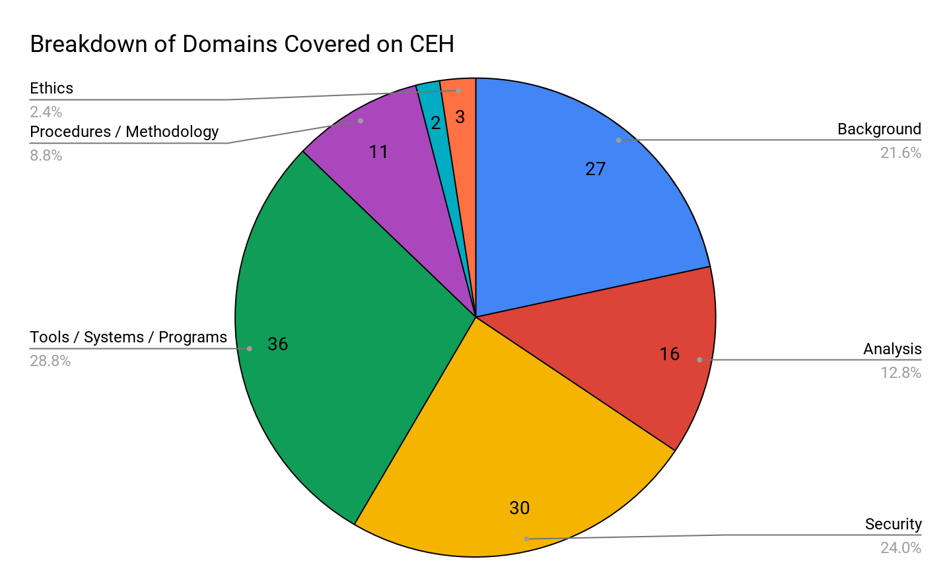
CEH Topics Breakdown
Background
Analysis / Assessment
Security
Tools/ Systems/ Programs
Procedures/ Methodology
Regulations / Policy
Ethics

Slide 12

Domain 1: Background
Subtopics Included:
Networking technologies
Web technologies
System technologies
Communication Protocols
Malware Operations
Mobile technologies
Telecommunications Technologies
Backups and archiving

Slide 13
Domain 1: Background
Subtopics Covered In-Class:
Networking technologies - Networking 101, Networking Security
Web technologies - Cyber 101, Web Development
System technologies - Cyber 101, Networking 101, Operating Systems
Communication Protocols- Networking 101, Networking Security
Malware Operations- Penetration Testing, Web Vulnerabilities
Mobile technologies- Not Covered
Telecommunications Technologies- Not Covered
Backups and archiving- Not Covered

Slide 14

Sample Question #1
Which of these options is the most secure procedure for strong backup tapes?
In a climate controlled facility offsite.
Inside the data center for faster retrieval in a fireproof safe.
In a cool dry environment.
On a different floor in the same building.

Slide 15
Sample Question #1
Which of these options is the most secure procedure for strong backup tapes?
In a climate controlled facility offsite.
Inside the data center for faster retrieval in a fireproof safe.
In a cool dry environment.
On a different floor in the same building.

Slide 16
Sample Question #2
Which of the following is the greatest threat posed by backups?
An un-encrypted backup can be misplaced or stolen.
A back is incomplete because no verification was performed.
A backup is the source of Malware or illicit information.
A backup is unavailable during disaster recovery.

Slide 17
Sample Question #2
Which of the following is the greatest threat posed by backups?
An un-encrypted backup can be misplaced or stolen.
A back is incomplete because no verification was performed.
A backup is the source of Malware or illicit information.
A backup is unavailable during disaster recovery.

Slide 18
Domain 2: Analysis and Assessment
Subtopics Included:
Data Analysis
System Analysis
Risk Assessment
Technical assessment methods

Slide 19
Domain 2: Analysis and Assessment
Subtopics Covered in Class:
Data Analysis - SIEMS
System Analysis - Operating Systems, SIEMS
Risk Assessment - GRC
Technical assessment methods - Not Covered

Slide 20
Sample Question #1
In Risk Management, how is the term “likelihood” related to the concept of "threat?"
Likelihood is the probability that a vulnerability is a threat-source.
Likelihood is a possible threat-source that may exploit a vulnerability.
Likelihood is the likely source of a threat that could exploit a vulnerability.
Likelihood is the probability that a threat-source will exploit a vulnerability.

Slide 21
Sample Question #1
In Risk Management, how is the term “likelihood” related to the concept of "threat?"
Likelihood is the probability that a vulnerability is a threat-source.
Likelihood is a possible threat-source that may exploit a vulnerability.
Likelihood is the likely source of a threat that could exploit a vulnerability.
Likelihood is the probability that a threat-source will exploit a vulnerability.

Slide 22
Sample Question #2
Threats x Vulnerabilities is referred to as the:
Threat assessment
Disaster recovery formula
BIA equation
Risk equation

Slide 23
Sample Question #2
Threats x Vulnerabilities is referred to as the:
Threat assessment
Disaster recovery formula
BIA equation
Risk equation

Slide 24
Sample Question #3
________________ is an entity or event with the potential to adversely impact a system through unauthorized access, destruction, disclosures, denial of service, or modification of data.
Threat
Attack
Risk
Vulnerability

Slide 25
Sample Question #3
________________ is an entity or event with the potential to adversely impact a system through unauthorized access, destruction, disclosures, denial of service, or modification of data.
Threat
Attack
Risk
Vulnerability

Slide 26
Domain 3: Security
Subtopics Included:
Social Engineering
Vulnerability Scanners
Security policy implications
Privacy/ confidentiality
Biometrics
Wireless access technology
Trusted Networks
Vulnerabilities
Systems security controls
Application/file server
Firewalls
Cryptography
Network Security
Physical Security
Threat Modeling
Verification procedures

Slide 27
Domain 3: Security
Subtopics Covered In-Class:
Social Engineering - Penetration Testing
Vulnerability Scanners - Penetration Testing
Security policy implications - Penetration Testing
Privacy/ confidentiality - Penetration Testing
Biometrics - Not Covered
Wireless access technology - Not Covered
Trusted Networks -Not Covered
Vulnerabilities - Web Vulnerabilities, Penetration Testing
Systems security controls - Network Security
Application/file server - Web Vulnerabilities
Firewalls - Network Security
Cryptography - Cryptography
Network Security - Network Security
Physical Security - Not Covered
Threat Modeling - GRC
Verification procedures - SIEMS

Slide 28
Sample Question #1
Which of the following tools can be used for passive OS fingerprinting?
tcpdump
ping
nmap
Tracert

Slide 29
Sample Question #1
Which of the following tools can be used for passive OS fingerprinting?
tcpdump
ping
nmap
Tracert

Slide 30
Sample Question #2
Which of the following is a low-tech way of gaining unauthorized access to systems?
Sniffing
Social engineering
Scanning
Eavesdropping

Slide 31
Sample Question #2
Which of the following is a low-tech way of gaining unauthorized access to systems?
Sniffing
Social engineering
Scanning
Eavesdropping

Slide 32
Sample Question #3
Which of the following statements is TRUE?
Sniffers operation on Layer 3 of the OSI model
Sniffers operation on Layer 2 of the OSI model
Sniffers operation on the Layer 1 of the OSI model
Sniffers operation on both Layer 2 & Layer 3 of the OSI model

Slide 33
Sample Question #3
Which of the following statements is TRUE?
Sniffers operation on Layer 3 of the OSI model
Sniffers operation on Layer 2 of the OSI model
Sniffers operation on the Layer 1 of the OSI model
Sniffers operation on both Layer 2 & Layer 3 of the OSI model

Slide 34
Domain 4: Tools / Systems Programs
Subtopics Included:
Port Scanning
Domain Name System
Routers/modems/switches
Vulnerability scanners
Vulnerability management
Operating environments
Antivirus Systems
Log analysis tools
Exploitation tools
Network /host-based infusion
Network sniffers
Access control mechanisms
Cryptography Techniques
Programming Languages
Scripting Languages
Boundary protection appliances
Networking topologies
Subnetting

Slide 35
Domain 4: Tools / Systems Programs
Subtopics Included:
Port Scanning - NetSec
Domain Name System - Networking 101
Routers/modems/switches - Networking 101
Vulnerability scanners - Penetration Testing
Vulnerability management - Pentest, Web Vulns
Operating environments - Linux / Windows OS
Antivirus Systems - Network Security
Log analysis tools - SIEM
Exploitation tools - Pentest
Network /host-based infusion- Net 101, NetSec
Network sniffers- Net 101, NetSec
Access control mechanisms- Not Covered
Cryptography Techniques - Cryptography
Programming Languages - Python
Scripting Languages- Web Development
Boundary protection appliances - Net Sec
Networking topologies - Net 101, NetSec
Subnetting - Not covered

Slide 36
Sample Question #1
Which of the following is a command line packet analyzer similar to GUI-based Wireshark?
Jack the ripper
Nessus
Tcpdump
Ethereal

Slide 37
Sample Question #1
Which of the following is a command line packet analyzer similar to GUI-based Wireshark?
Jack the ripper
Nessus
Tcpdump
Ethereal

Slide 38
Sample Question #2
What does a firewall check to prevent particular ports and applications from getting packets into an organizations?
Transport layer port numbers and application layer headers
Network layer headers and the session layer port numbers
Application layer port numbers and the transport layer headers
Presentation layer headers and the session layer port numbers

Slide 39
Sample Question #2
What does a firewall check to prevent particular ports and applications from getting packets into an organizations?
Transport layer port numbers and application layer headers
Network layer headers and the session layer port numbers
Application layer port numbers and the transport layer headers
Presentation layer headers and the session layer port numbers

Slide 41
The following domains were not covered in class...

Slide 42
Domain 5: Procedures and Methodology
Subtopics Included:
Public Key Infrastructure (PKI)
Security Architecture
Service-Oriented Architecture
Information security design
N-tier application design
TCP/IP networking
Security testing methodology

Slide 43
Sample Question #1
A Regional bank hires your company to perform a security assessment on their network after a recent data breach. The attacker was able to steal financial data from the bank by compromising only a single server. Based on this information, what should be one of your key recommendations to the bank?
Move the financial data to another server on the same IP subnet
Place a front-end web server in a demilitarized zone that only handles external web traffic
Issue new certificates to the web servers from the root certificate authority
Require all employees to change their passwords immediately

Slide 44
Sample Question #1
A Regional bank hires your company to perform a security assessment on their network after a recent data breach. The attacker was able to steal financial data from the bank by compromising only a single server. Based on this information, what should be one of your key recommendations to the bank?
Move the financial data to another server on the same IP subnet
Place a front-end web server in a demilitarized zone that only handles external web traffic
Issue new certificates to the web servers from the root certificate authority
Require all employees to change their passwords immediately

Slide 45
Sample Question #2
You've just been hired to perform a pentest on an organization that has been subjected to a large-scale attack. The CIO is concerned with mitigating threats and vulnerabilities to totally eliminate risk. What is one of the first thing you should to when the job?
Start the wireshark application to start sniffing network traffic.
Establish attribution to suspected attackers.
Explain to the CIO that you cannot eliminate all risk, but you will be able to reduce risk to acceptable levels.
Interview all employees in the company to rule out possible insider threats.

Slide 46
Sample Question #2
You've just been hired to perform a pentest on an organization that has been subjected to a large-scale attack. The CIO is concerned with mitigating threats and vulnerabilities to totally eliminate risk. What is one of the first thing you should to when the job?
Start the wireshark application to start sniffing network traffic.
Establish attribution to suspected attackers.
Explain to the CIO that you cannot eliminate all risk, but you will be able to reduce risk to acceptable levels.
Interview all employees in the company to rule out possible insider threats.

Slide 47
Domain 6: Regulation / Policy
This section of the exam tests knowledge of major information security regulations and evaluations of corporation’s security policies.
Sample Question:
To maintain compliance with regulatory requirements, a security audit of the systems on a network must be performed to determine their compliance with security policies. Which one of the following tools would most likely be used in such as audit?
Port scanner
Protocol analyzer
Vulnerability scanner
Intrusion Detection System

Slide 48
Domain 6: Regulation / Policy
This section of the exam tests knowledge of major information security regulations and evaluations of corporation’s security policies.
Sample Question:
To maintain compliance with regulatory requirements, a security audit of the systems on a network must be performed to determine their compliance with security policies. Which one of the following tools would most likely be used in such as audit?
Port scanner
Protocol analyzer
Vulnerability scanner
Intrusion Detection System

Slide 49
Domain 7: Ethics
This section of the exam tests knowledge of how to behave appropriately in situations that you may encounter as an ethical hacker.
Sample Question:
Which of the following statements regarding ethical hacking is incorrect?
Testing should be remotely performed offsite.
Ethical hackers should never use tools that have potential of exploiting vulnerabilities in the organizations IT system.
Ethical hacking should not involve writing to or modifying the target systems.
An organization should use ethical hackers who do not sell hardware/software or other consulting services.

Slide 50
Domain 7: Ethics
This section of the exam tests knowledge of how to behave appropriately in situations that you may encounter as an ethical hacker.
Sample Question:
Which of the following statements regarding ethical hacking is incorrect?
Testing should be remotely performed offsite.
Ethical hackers should never use tools that have potential of exploiting vulnerabilities in the organizations IT system.
Ethical hacking should not involve writing to or modifying the target systems.
An organization should use ethical hackers who do not sell hardware/software or other consulting services.

Slide 51
Activity: Practice Quiz
In this activity, you will complete a practice CEH exam.
The purpose of this review is not to achieve a perfect score. It should be used as an opportunity to find less competent areas that you should focus on studying and preparing for.
Exam sent via Slack.
1 hour
Notes:
https://www.eccouncil.org/programs/certified-ethical-hacker-ceh/ceh-assessment/

